Slide 1

Changes in life values for females of different age groups
Rhoan Lee
rl3405

Slide 2
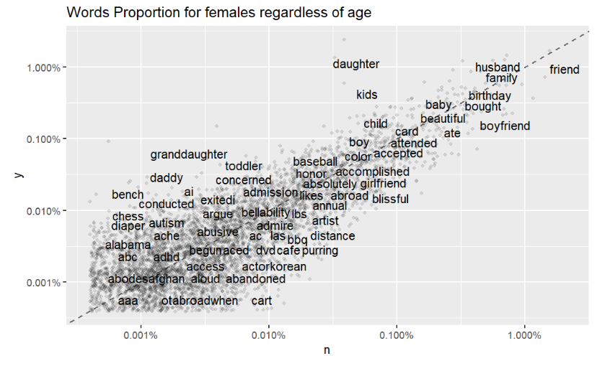
Question 1: What makes females of different age groups happy?

Slide 3

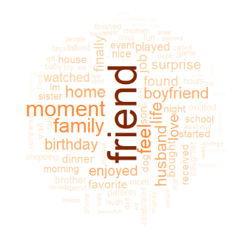
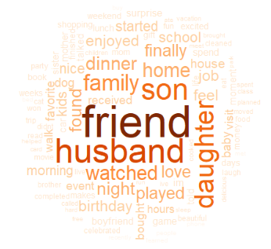
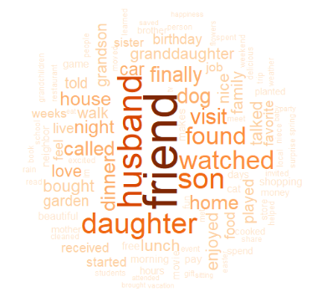
Female_10s (10 =< age < 20)
Female_20s (20 =< age < 30)
Female_30s (30 =< age < 40)
Female_60s (60 =< age < 70)

Slide 4
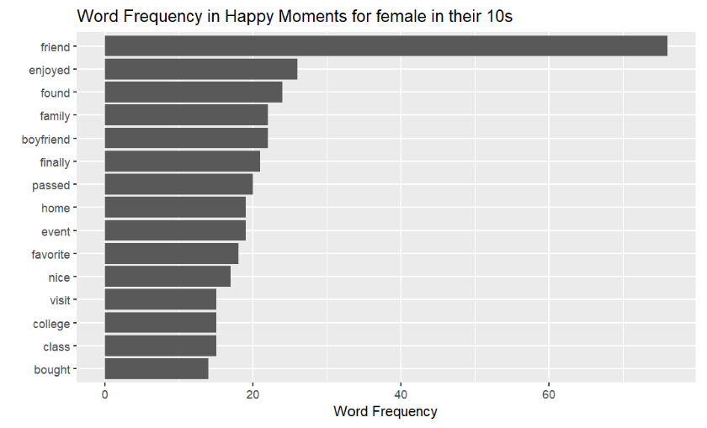
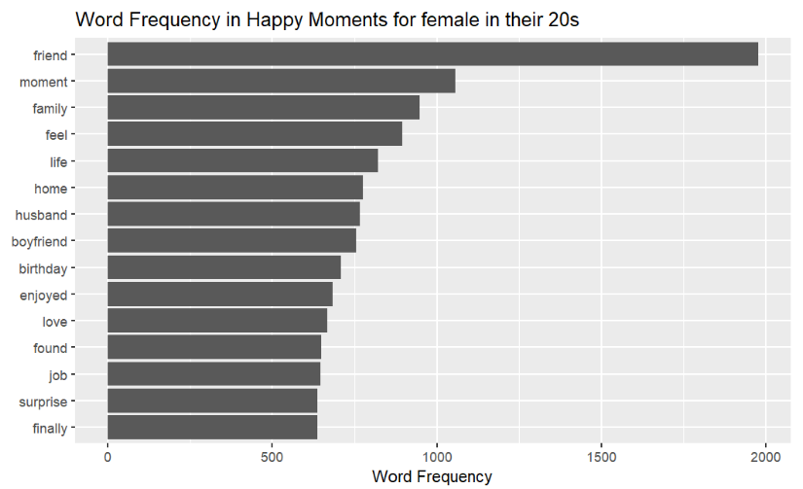
Female_10s (10 =< age < 20)
Female_20s (20 =< age < 30)

Slide 5
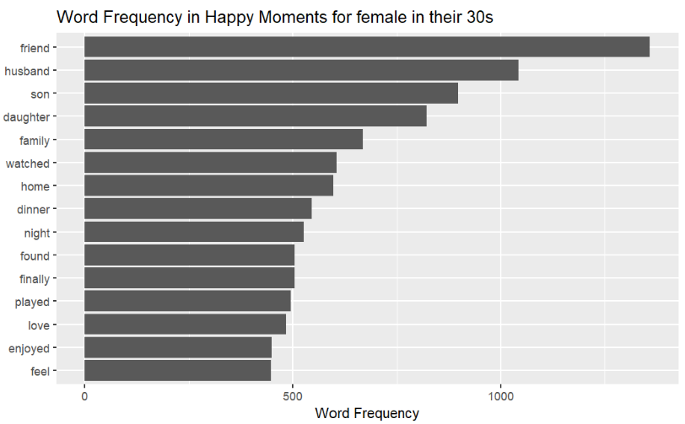
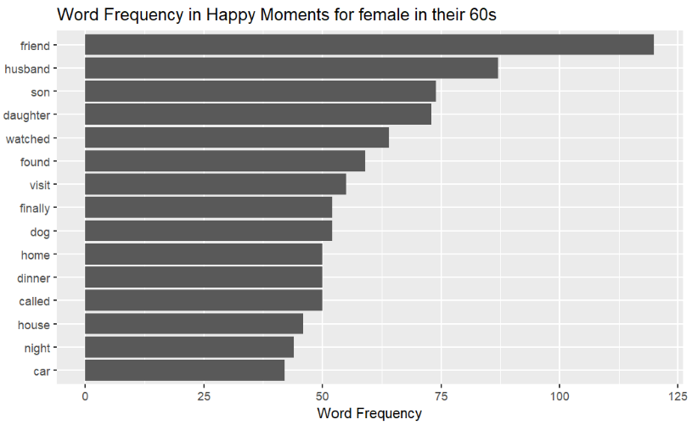
Female_30s (30 =< age < 40)
Female_60s (60 =< age < 70)

Slide 6

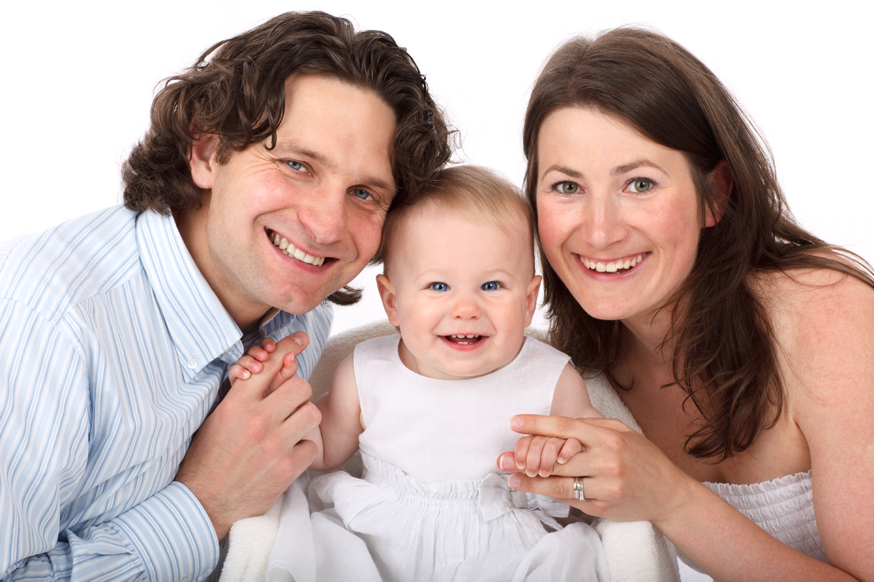
Question 2: Other than friends and families, which factors make females happy?

Slide 7
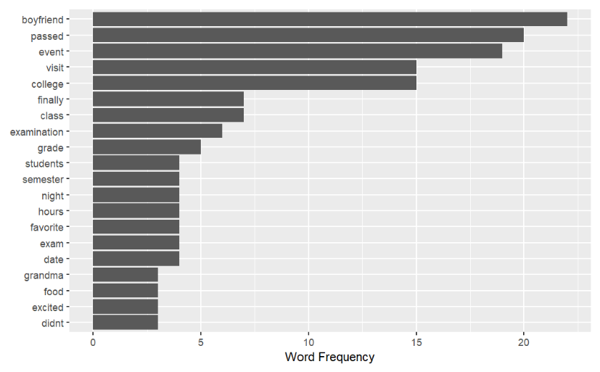

Female in their 10s

Slide 8
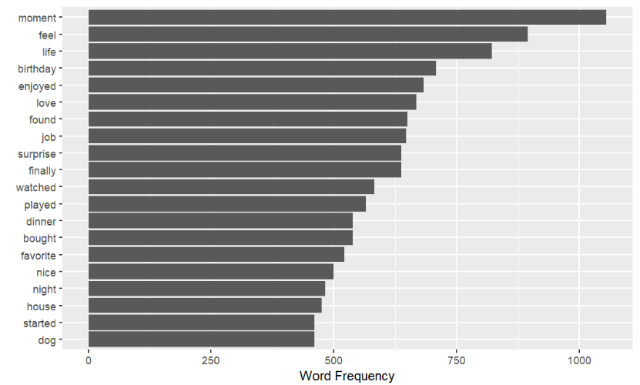
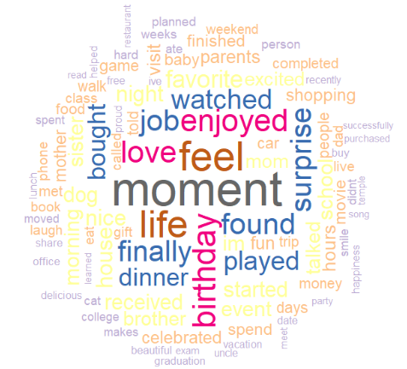
Female in their 20s

Slide 9
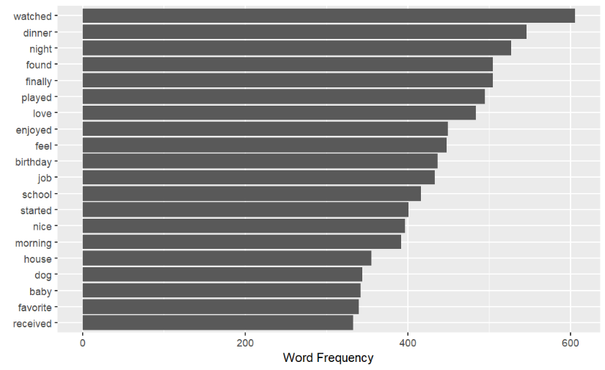
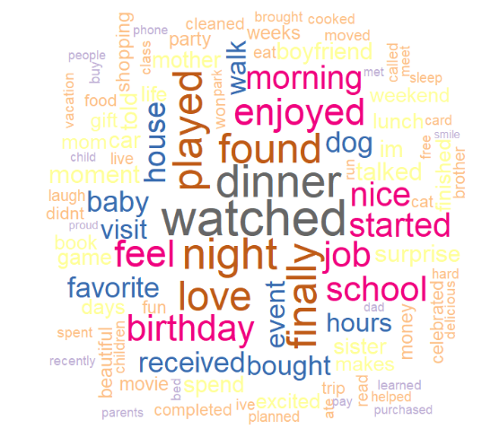
Female in their 30s

Slide 10
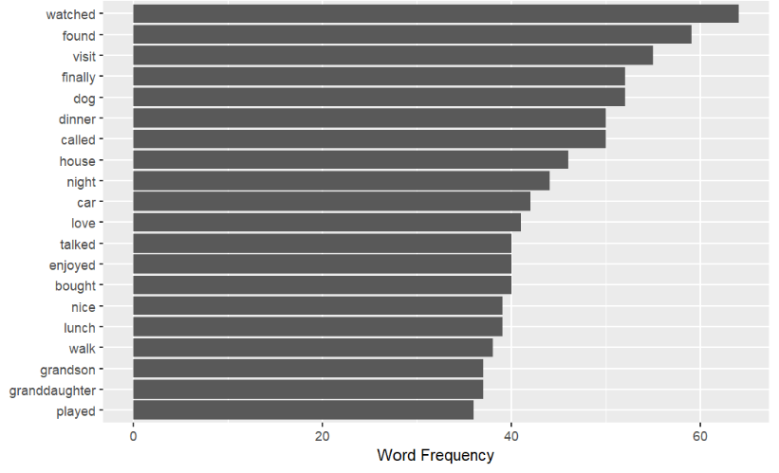
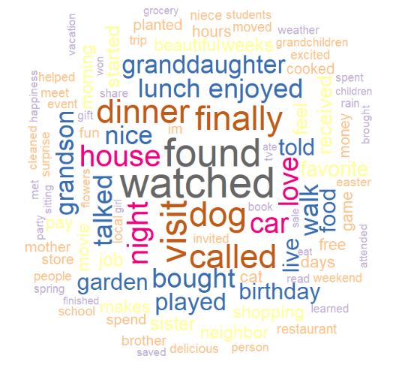
Female in their 60s

Slide 11
Conclusions 1. ‘Friend’ and ‘Family’ were always mentioned as a top value of all different age groups. 2. For females in 10s and 20s, it could be inferred that they had other external factors such as ‘college’, ‘boyfriend’, ‘life’, or ‘job’ to make them happy. 3. For females in 30s and 60s, it could be inferred that internal factors, or the action of doing something with people around you, inferably friends or families, were what made them happy.

